Slide 1

Quantitative hydrologic storylines
Julie Vano, Ethan Gutmann, Martyn Clark, Andy Wood, Nans Addor, Andy Newman (NCAR)
Jeff Arnold (USACE)
Bart Nijssen (University of Washington)
Meeting at U.S. Army Corps of Engineers, Seattle District Offices
Seattle, Washington, June 2016
Notes:
XXX other folks to add?

Slide 2
Quantitative Hydrologic Storylines
Our motivation
The storylines concept
Opportunities for demonstration projects
Discussion: directions forward

Slide 3
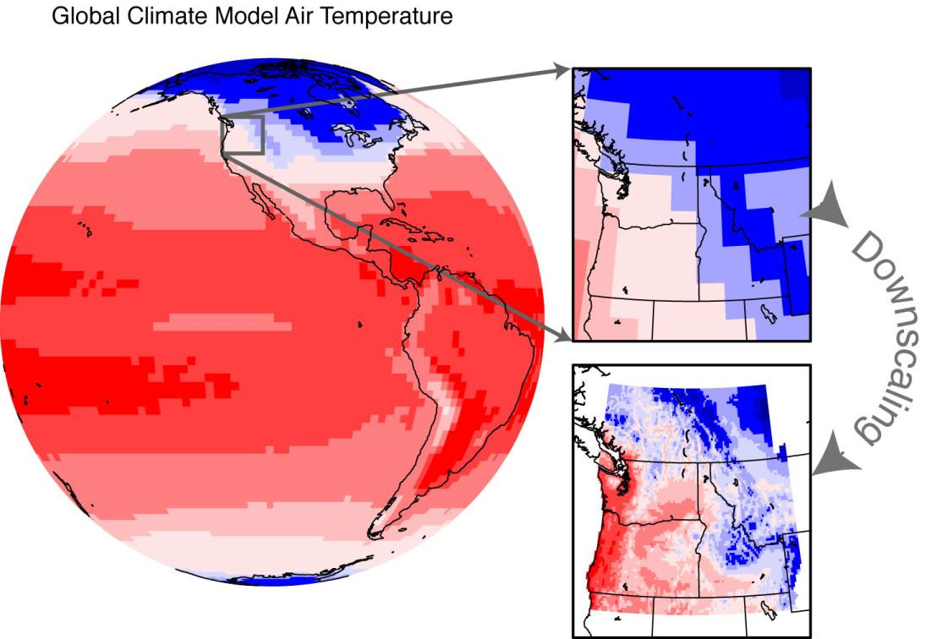
Motivation
statistical, psuedo-dynamical, dynamical techniques
How do we translate global information to address local-scale climate impacts?
Figure courtesy of Climate Impacts Group

Slide 4
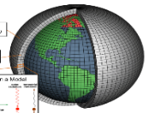
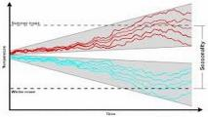
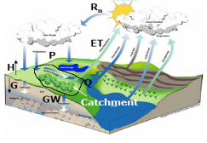
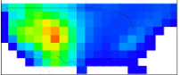
Motivation
PDF
Emissions
Scenario(s)
Combined uncertainty
scenarios
PDF
projections
PDF
Global Climate
Model(s)
models
PDF
calibration
PDF
PDF
Hydrologic
Model
Parameter(s)
PDF
GCM initial conditions
ens. members
models
methods
Downscaling
method (s)
Hydrologic
Model
Structure(s)

Slide 5
Motivation
PDF
Emissions
Scenario(s)
Combined uncertainty
scenarios
PDF
projections
PDF
Global Climate
Model(s)
models
PDF
PDF
calibration
PDF
Hydrologic
Model
Parameter(s)
GCM initial conditions
ens. members
PDF
structure
methods
Downscaling
method (s)
Hydrologic
Model
Structure(s)

Slide 6

Motivation
Great, but… how do we deal with all that information?
Image from http://www.activatedesign.co.nz/blog/the-frustration-of-almost-perfect-websites/

Slide 7
Culling example, Global Climate Models
Ranking for
Pacific Northwest by Rupp et al. JGR 2013.
But only one part of the chain...

Slide 8
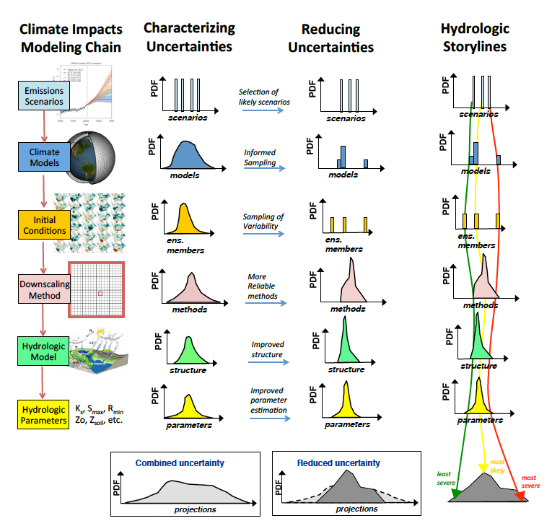
The storylines concept
Explicitly estimate dominant sources of uncertainty in order to characterize the range of outcomes
Notes:
EMBRACING UNCERTAINTY

Slide 9
The storylines concept
Explicitly estimate dominant sources of uncertainty in order to characterize the range of outcomes
Reduce uncertainties
Sample from the range to construct storylines useful for water resources planning
Notes:
EMBRACING UNCERTAINTY
Consider model diversity

Slide 10
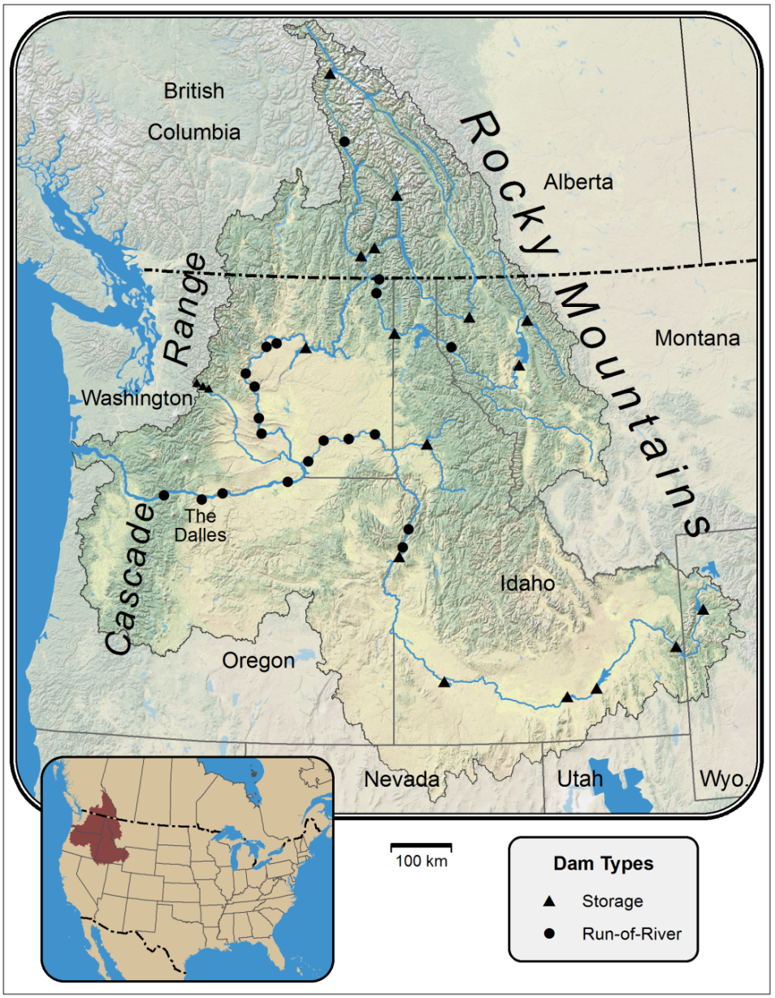


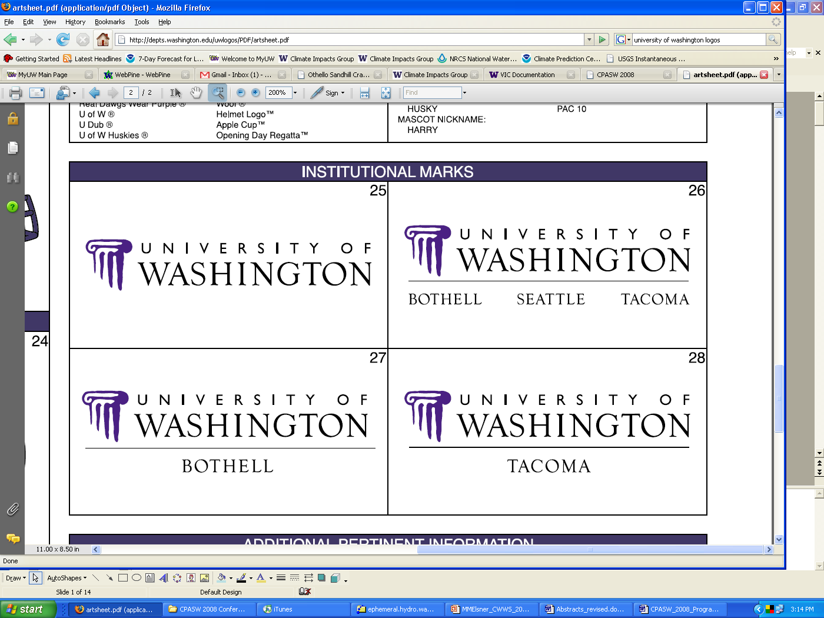
Demonstration of concept, RMJOC II
Period: 1950-2100
2 hydrologic models with 3 parameter sets for one model
2 statistical downscaling methods
10 global climate models (CMIP5)
2 representative concentration pathways
a limited number of dynamical downscaling WRF (+12)
Figure: Robert Norheim, Climate Impacts Group
4 x 2 x 10 x 2 +12 = 172 future hydrologic scenarios
Notes:
River Management Joint Operating Committee (RMJOC II) Project
BCSD, MACA (?)
VIC, ULM (NOAH/SAC-SMA), PRMS
RCP 4.5, RCP 8.5
three different sets of VIC parameters (our own parameters calibrated in-house, a set from Martyn Clark and a set from Shih-Chieh Kao at ORNL)
will be simulating the coastal drainages, but not calibrating them.

Slide 11
Demonstration of concept
Quantitative hydrologic storylines for the PNW
Select 1-3 locations:
e.g., Dworshak, Yakima River basin, Hungry Horse, Libby, Howard Hanson
Select 2-3 hydrologic impacts:
e.g., floods, summertime minimum flows, summer water supply

Slide 12
Demonstration of concept
Example questions:
Where is the majority of the variation coming from (e.g., GCMs or hydrologic model parameters)? Does this change with location or impact? If so, how?
Does storyline selection differ depending on (a) location, (b) impact being investigated, (c) number of storylines?
Can there be adequate coverage of uncertainty simultaneously at multiple (or all) locations?
What is the optimal or minimum number of storylines?
With what confidence can we select storylines that reflect the range/min/max/average without running all the models?

Slide 13
Directions forward, identify locations
Considerations for defining a location:
Engaged manager/decision maker
Location has 2-3 key, well-defined, decisions to explore
How the location is connected to larger system (at first more independent would be more tractable)
Other criteria?
What locations would help you?

Slide 14
Directions forward, identify impacts
Considerations for defining a impact:
Does the impact (e.g., flooding) effect a particular decision (e.g., releases in X)?
Is it an objective decision?
Other criteria?
Examples:
flows above X value at X time of year
X days of flows below X
X amount of water from April-July

Slide 15
Discussion items….
Location recommendations?
Impact recommendations?
Timeline considerations
Other thoughts?

Slide 16
More….
Extra Slides

Slide 17
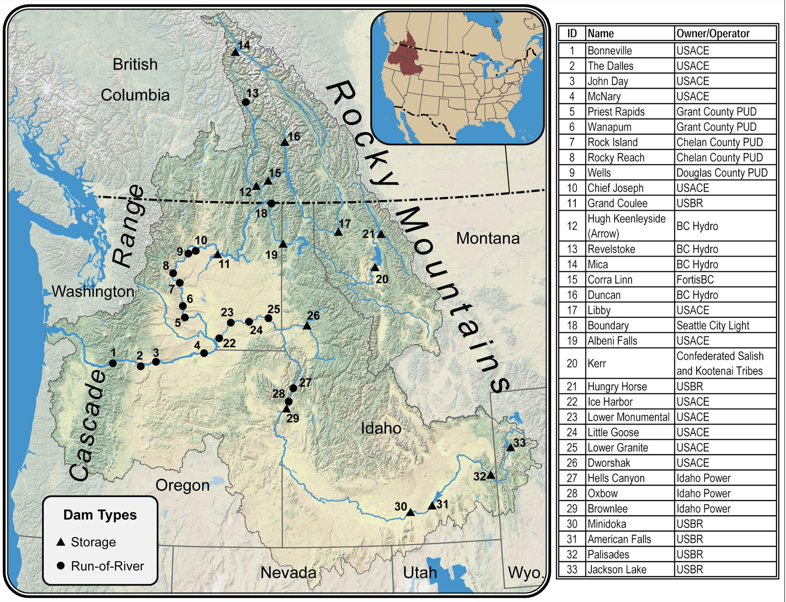
Location possibilities
Map by Robert Norheim
Figure from Vano et al., Handbook of Applied Hydrology, in press

Slide 18
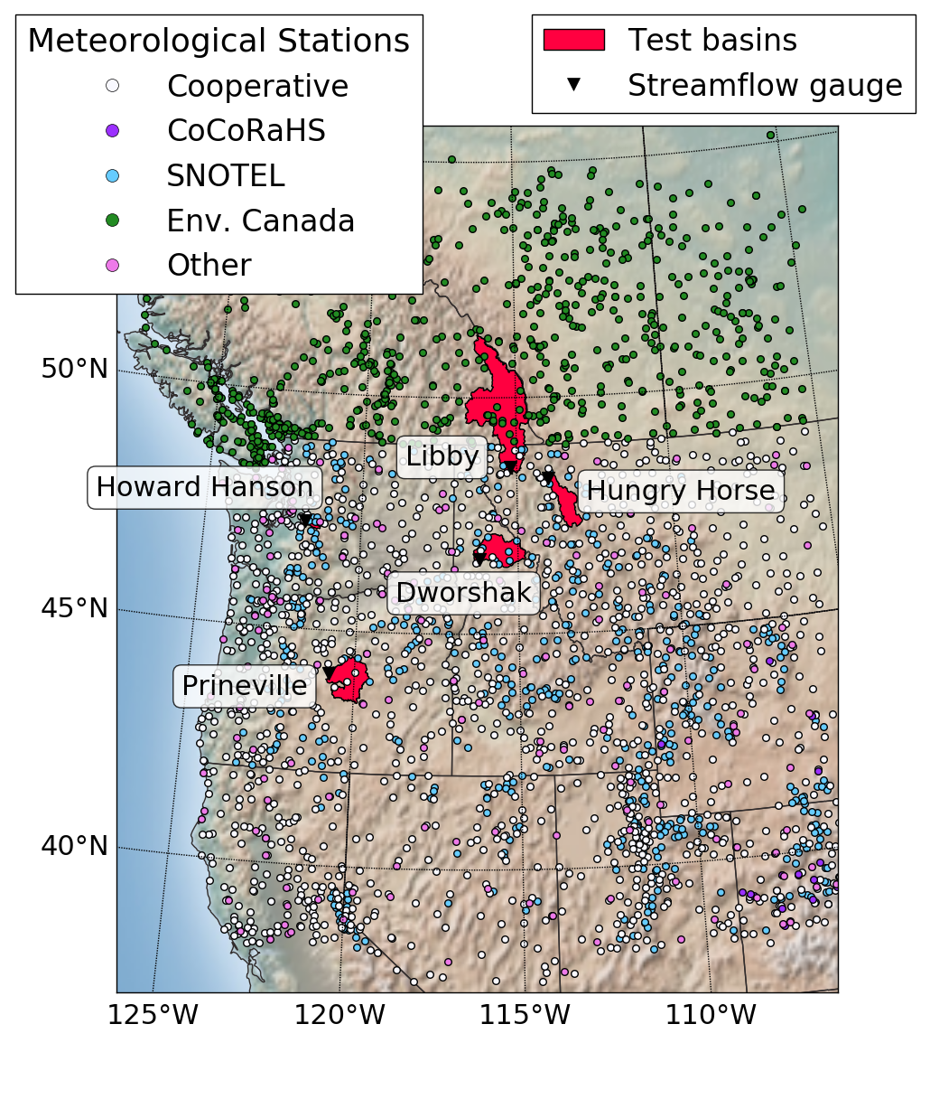
Location possibilities
Figure from Elizabeth Clark, University of Washington

Slide 19
Climate Impacts Modeling Chain
Current generation
Next generation
Observed forcings
& Climate Models
1. GMET
Observed forcings
ensembles &
Climate Models
downscaling
2. ICAR+
downscaling
(statistical re-scaling, computation-limited dynamical)
(+ large ensemble quasi-dynamical, circulation-based statistical)
Hydrology Model
(single model,
single parameterization)
3. SUMMA
Flexible Hydrological
Modeling Framework
4. MPR-flex
stream routing
5. mizuRoute
stream routing
(grid-based)
(spatially variable)
Climate
Impact
Climate Impact
& Adaptations
6. SHARP

Slide 20
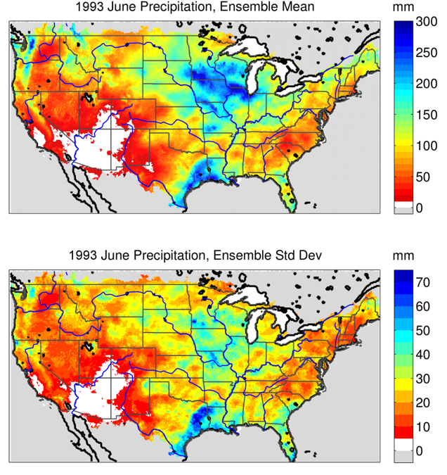
Deterministic and probabilistic climate data
Create gridded climate using methods outlined in Newman et al. [JHM, 2015] for contiguous United States
Aim to account for observational uncertainty (measurements and how measures interpolated across space), especially helpful when observations sparse or terrain complex
Coming soon to Alaska…
Figure: Gridded precipitation ensemble mean (top) and standard deviation (bottom) during the Mississippi River flood of 1993.
Notes:
Yet historical datasets that are created from observations for use in hydrological modeling are usually single time series interpolated to a grid. Not accounting for observational uncertainty, both in the measurements themselves and how they are interpolated across space, is especially problematic when either observations are sparse or the terrain is complex.
GMET automates the many steps needed to translate station data to gridded ensembles: (1) ingests station data, current simulations draw from over 12,000 unique stations, (2) insures stations are serially complete (rejects records too short to be validated and fills data gaps using well-established methods), (3) interpolates precipitation and temperature time series using distance-dependent weights, precipitation occurrence probabilities, and uncertainty estimations; algorithms which incorporate locally varying weights and spatial attributes (e.g. latitude, elevation, topographic slope), and (4) generates ensemble outcomes using spatially and temporally correlated random fields to sample from estimated distributions generated in the earlier step, which allows for consistent estimates of uncertainty in both space and time.
The 100-member ensemble dataset, described in Newman et al. [2015], compares well with established data products, allows for quantification of observational uncertainty, and is freely available at: http://dx. doi.org/10.5065/D6TH8JR2

Slide 21
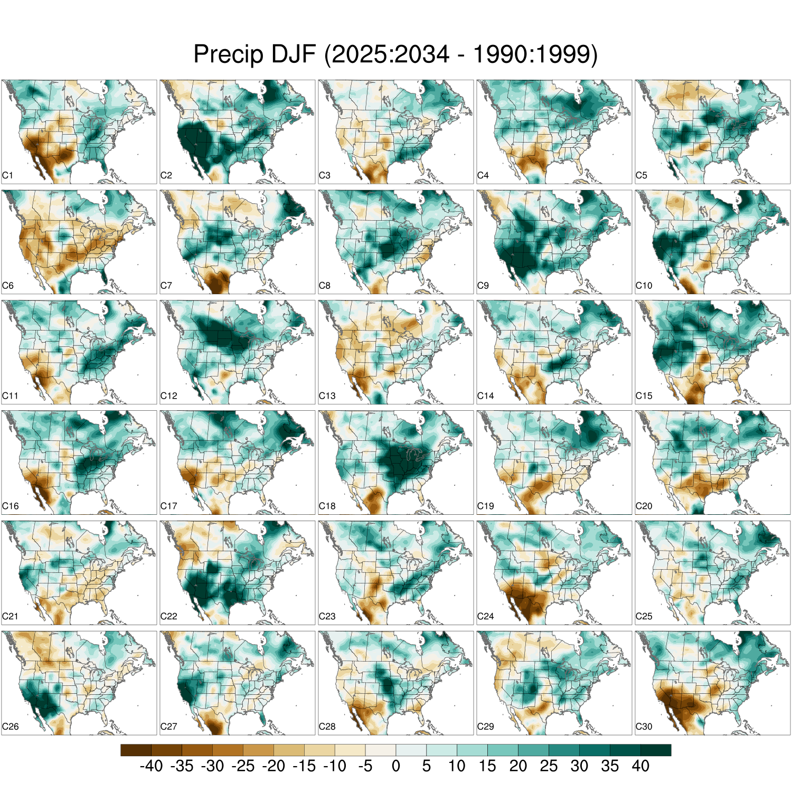
Internal Variability
30 Member CESM Ensemble
Random Perturbation to the Initial conditions
P+=1e-10… (a butterfly flapped it’s wings)

Slide 22
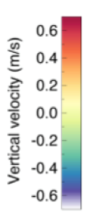
Intermediate Complexity Atmospheric Research model (ICAR)
Pseudo-dynamical Downscaling
Dichotomous end-members:
Statistical downscaling is computationally efficient (no physics)
Dynamical downscaling has loads of physics (too expensive)
Identify the key physics and develop a simple model
GOAL: >90% of the information for <1% of the cost
ICAR
Gutmann et al., JHM

Slide 23
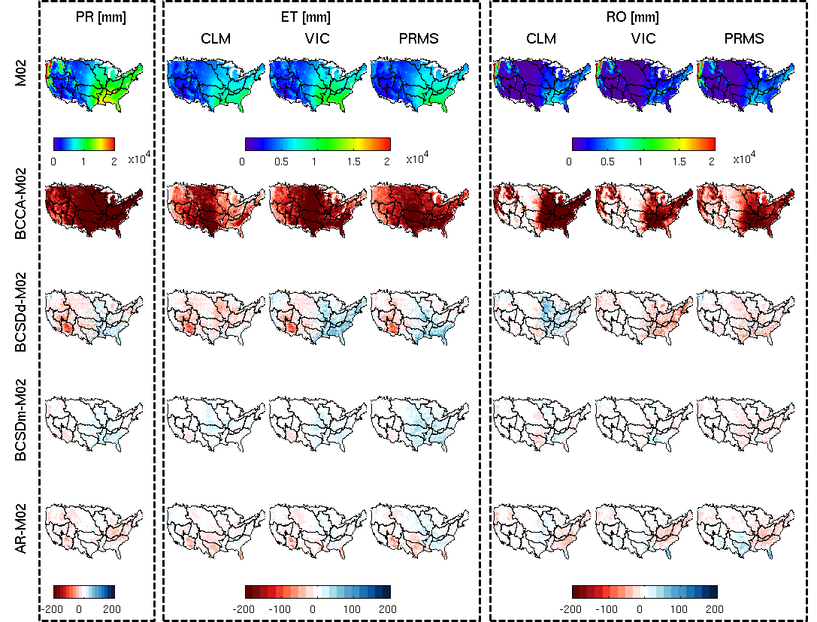
Current local-scale information
Annual water balance for four statistical downscaling methods and three hydrologic models for the contiguous United States, Mizukami et al., JHM, 2015

Slide 24
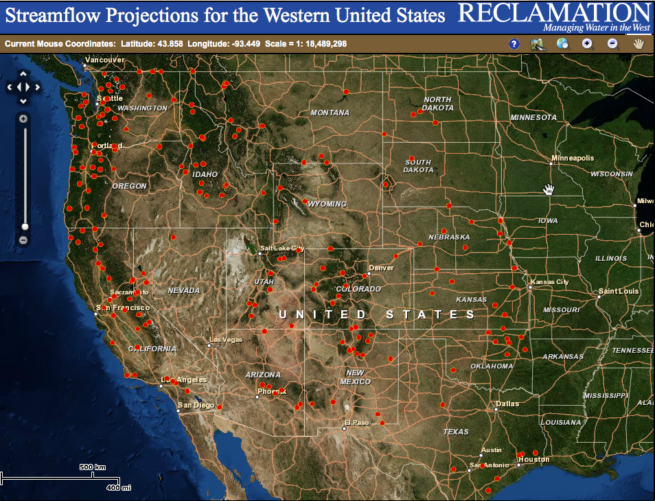
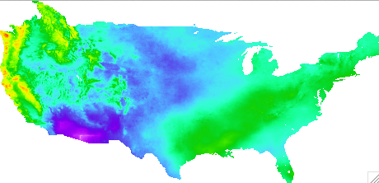
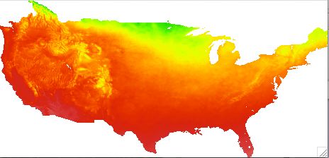
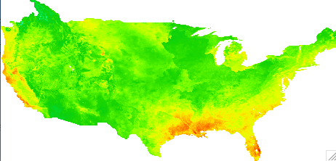
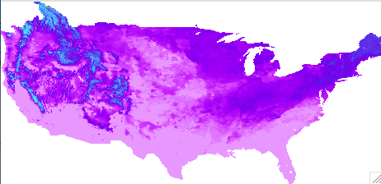
Current local-scale information
NCAR generated 97 CMIP5 scenario BCSD-based daily forcings and VIC hydrology datasets, together with ~500 routed streamflow locations for the contiguous United States
examples
precipitation
temperature
evapotranspiration
snow water equivalents

